Slide 1
CSE/T/324A Computer Networks Topic 2- Multiple Access Protocols
Dr. Sarbani Roy
sarbani.roy@gmail.com
Office: CC-5-7
Cell: 9051639328

Slide 2
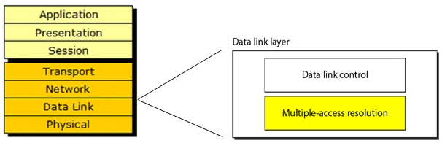
Data link layer divided into two functionality-oriented sublayers

Slide 3
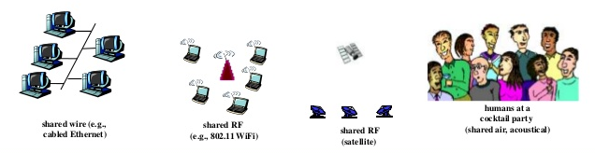
Multiple Access
Broadcast link used in LAN consists of multiple sending and receiving nodes connected to or use a single shared link

Slide 4
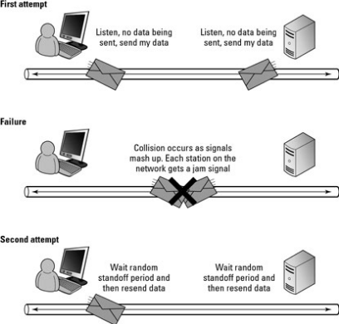
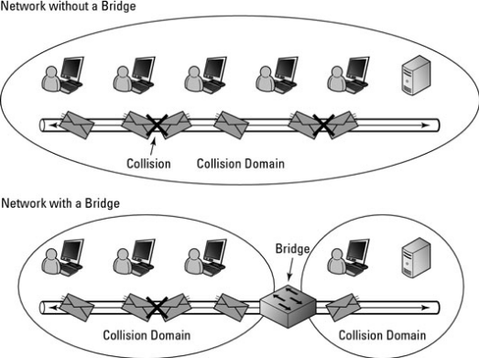
What is the problem?
When two or more nodes transmit at the same time, their frames will collide and the link bandwidth is wasted during collision

Slide 5
Problem: Coordination
How to coordinate the access of multiple sending/receiving nodes to the shared link???

Slide 6
Solution: MAC
Solution: We need a protocol to coordinate the transmission of the active nodes
These protocols are called Medium or Multiple Access Control (MAC) Protocols belong to a sublayer of the data link layer called MAC (Medium Access Control)

Slide 7
What is expected from MAC Protocols:
Main task is to minimize collisions in order to utilize the bandwidth by:
When a station can use the link (medium)? (Determining)
What a station should do when the link is busy?
What the station should do when it is involved in collision?

Slide 8
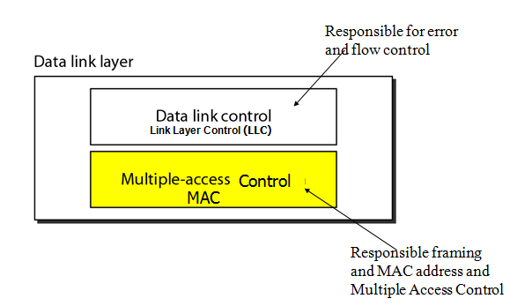
Data link layer divided into two functionality-oriented sublayers

Slide 9
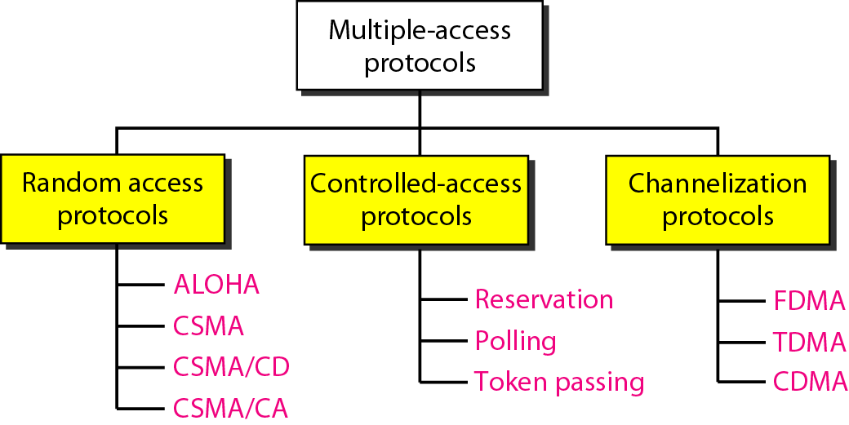
Taxonomy of multiple-access protocols

Slide 10
Random Access (or contention) Protocols
No station is superior to another station and none is assigned the control over another.
A station with a frame to be transmitted can use the link directly based on a procedure defined by the protocol to make a decision on whether or not to send.

Slide 11
Protocols
ALOHA
Carrier Sense Multiple Access (CSMA)
Carrier Sense Multiple Access with Collision Detection (CSMA/CD)
Carrier Sense Multiple Access with Collision Avoidance (CSMA/CA)

Slide 12
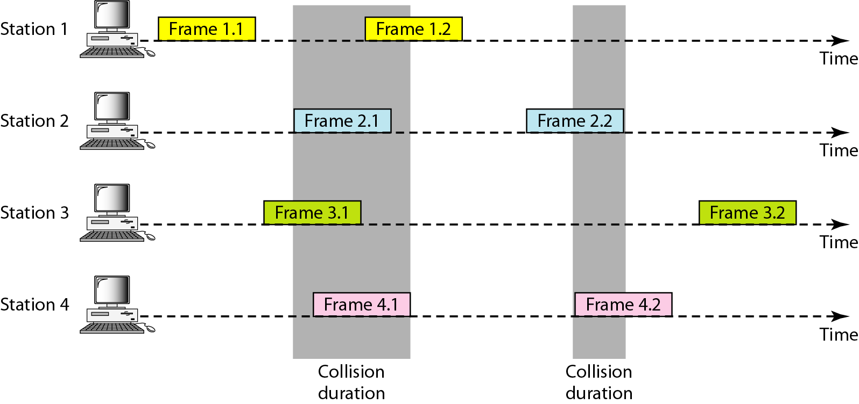
Frames in a pure ALOHA network
(Additive Links On-line Hawaii Area)

Slide 13
Pure ALOHA Protocol
If you have data to send, send the data
If, while you are transmitting data, you receive any data from another station, there has been a message collision. All transmitting stations will need to try resending "later".
Note that the first step implies that Pure ALOHA does not check whether the channel is busy before transmitting.
Since collisions can occur and data may have to be sent again, ALOHA cannot use 100% of the capacity of the communications channel.
How long a station waits until it transmits, and the likelihood a collision occurs are interrelated, and both affect how efficiently the channel can be used.
This means that the concept of "transmit later" is a critical aspect: the quality of the backoff scheme chosen significantly influences the efficiency of the protocol, the ultimate channel capacity, and the predictability of its behavior.

Slide 14
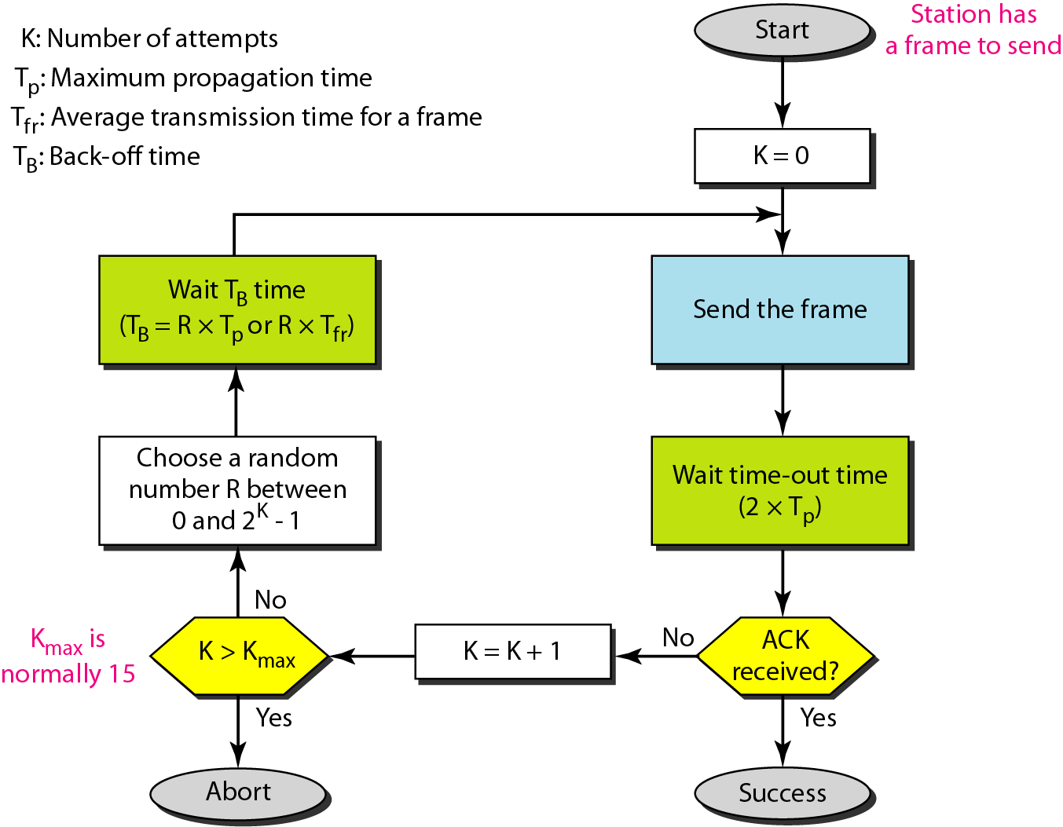
Procedure for pure ALOHA protocol

Slide 15
Example
The stations on a wireless ALOHA network are a maximum of 600 km apart. If we assume that signals propagate at 3 × 10⁸ m/s, we find
Tp = (600 km ) / (3 × 10⁸ m/s) = 2 ms.
Now we can find the value of T_{B} for different values of K .

Slide 16
Example …contd
For K = 1, the range is {0, 1}. The station needs to generate a random number with a value of 0 or 1. This means that T_{B} is either 0 ms (0 × 2) or 2 ms (1 × 2), based on the outcome of the random variable.
For K = 2, the range is {0, 1, 2, 3}. This means that T_{B} can be 0, 2, 4, or 6 ms, based on the outcome of the random variable.
For K = 3, the range is {0, 1, 2, 3, 4, 5, 6, 7}. This means that T_{B} can be 0, 2, 4, . . . , 14 ms, based on the outcome of the random variable.
We need to mention that if K > 10, it is normally set to 10.

Slide 17
Example
A pure ALOHA network transmits 200-bit frames on a shared channel of 200 kbps. What is the requirement to make this frame collision-free?

Slide 18
Solution
Average frame transmission time T_{fr} is 200 bits/200 kbps or 1 ms. The vulnerable time is 2 × 1 ms = 2 ms. This means no station should send later than 1 ms before this station starts transmission and no station should start sending during the one 1-ms period that this station is sending.

Slide 19
Throughput for pure ALOHA
To assess Pure ALOHA, there is a need to predict its throughput, the rate of (successful) transmission of frames. First, let's make a few simplifying assumptions:
All frames have the same length.
Stations cannot generate a frame while transmitting or trying to transmit. (That is, if a station keeps trying to send a frame, it cannot be allowed to generate more frames to send.)
The population of stations attempts to transmit (both new frames and old frames that collided) according to a Poisson distribution.

Slide 20

Throughput for pure ALOHA
The throughput can be calculated as the rate of transmission-attempts multiplied by the probability of success, and it can be concluded that the throughput (Spure) is:

Slide 21
Throughput for pure ALOHA
Let "T" refer to the time needed to transmit one frame on the channel, and let's define "frame-time" as a unit of time equal to T.
Let "G" refer to the mean used in the Poisson distribution over transmission-attempt amounts: that is, on average, there are G transmission-attempts per frame-time.
Consider what needs to happen for a frame to be transmitted successfully.
Let "t" refer to the time at which it is intended to send a frame. It is preferable to use the channel for one frame-time beginning at t, and all other stations to refrain from transmitting during this time.

Slide 22



Throughput for pure ALOHA
For any frame-time, the probability of there being k transmission-attempts during that frame-time is:
The average amount of transmission-attempts for 2 consecutive frame-times is 2G. Hence, for any pair of consecutive frame-times, the probability of there being k transmission-attempts during those two frame-times is:
Therefore, the probability (Probpure) of there being zero transmission-attempts between t-T and t+T (and thus of a successful transmission for us) is:

Slide 23
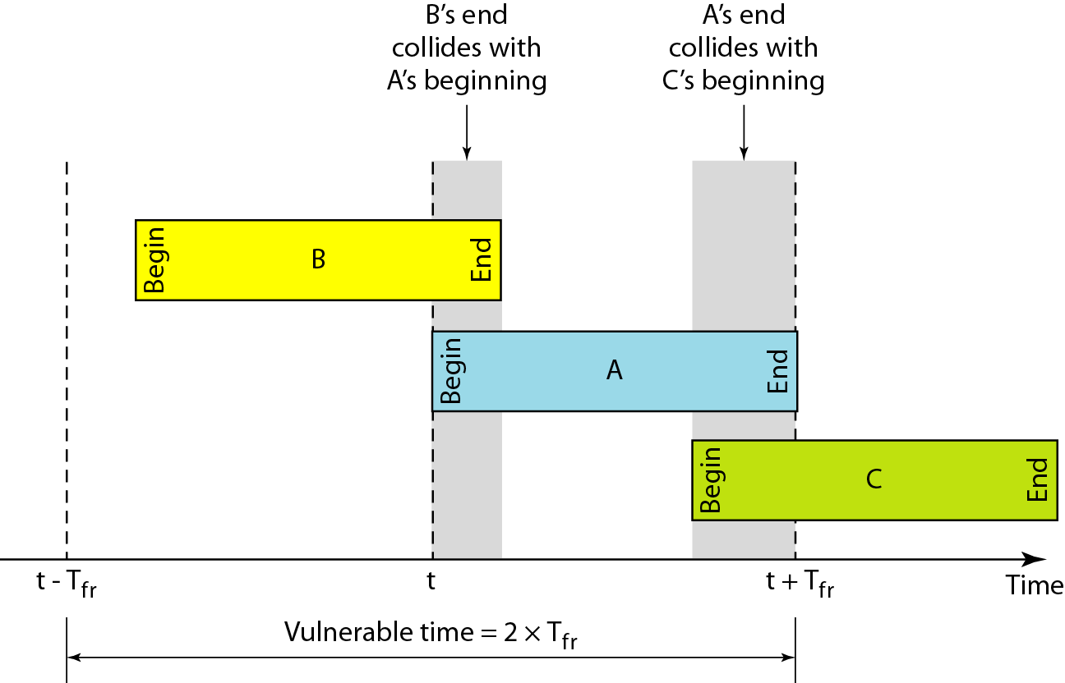
Vulnerable time for pure ALOHA protocol

Slide 24
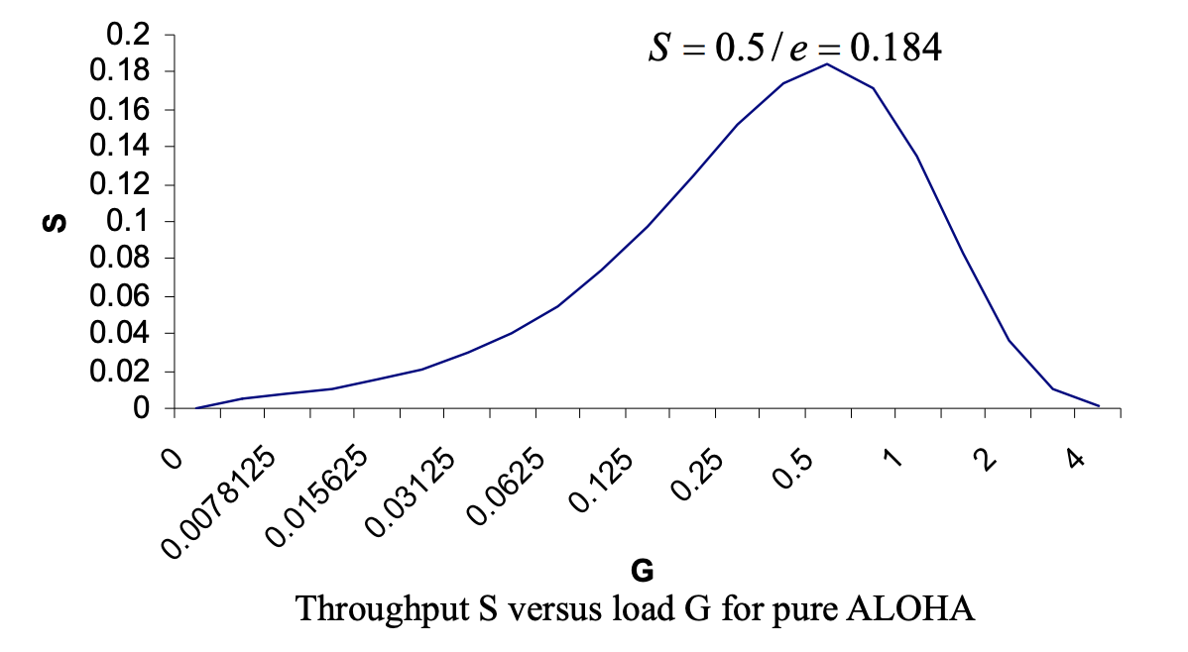
Throughput S versus load G for Pure ALOHA
The maximum throughput occurs at G = 0.5, which is approximately 0.18 frames per frame-time. This means that, in Pure ALOHA, only about 18% of the time is used for successful transmissions i.e., 82% of frames end up in collisions and are therefore lost.

Slide 25
Example
A pure ALOHA network transmits 200-bit frames on a shared channel of 200 kbps. What is the throughput if the system (all stations together) produces
a. 1000 frames per second b. 500 frames per second c. 250 frames per second.

Slide 26
Solution
The frame transmission time is 200/200 kbps or 1 ms.
a. If the system creates 1000 frames per second, this is 1 frame per millisecond. The load is 1. In this case S = G× e−2 G or S = 0.135 (13.5 percent). This means that the throughput is 1000 × 0.135 = 135 frames. Only 135 frames out of 1000 will probably survive.
b. If the system creates 500 frames per second, this is (1/2) frame per millisecond. The load is (1/2). In this case S = G × e −2G or S = 0.184 (18.4 percent). This means that the throughput is 500 × 0.184 = 92 and that only 92 frames out of 500 will probably survive. Note that this is the maximum throughput case, percentagewise.

Slide 27
c. If the system creates 250 frames per second, this is (1/4) frame per millisecond. The load is (1/4). In this case S = G × e ^−2G or S = 0.152 (15.2 percent). This means that the throughput is 250 × 0.152 = 38. Only 38 frames out of 250 will probably survive.

Slide 28
Disadvantages of Pure ALOHA
Time is wasted
Data is lost
Now think …how we can improve

Slide 29
Frames in a pure ALOHA network

Slide 30
Vulnerable time for pure ALOHA protocol

Slide 31
Slotted ALOHA
Pure ALOHA has a vulnerable time of 2Tfr
This is so because there is no rule that defines when the station can send.
A station may send soon after another station has started or soon before another station has finished.
Slotted ALOHA was invented to improve the efficiency of pure ALOHA.

Slide 32
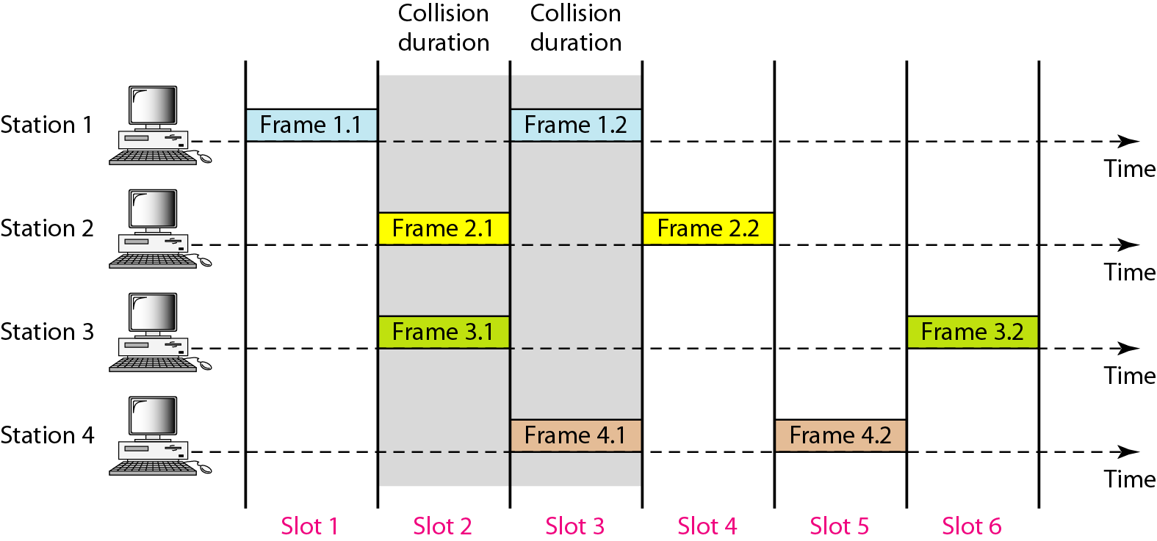
Frames in a slotted ALOHA network

Slide 33
Slotted ALOHA
A station can start a transmission only at the beginning of a timeslot, and thus collisions are reduced. In this case, only transmission-attempts within 1 frame-time and not 2 consecutive frame-times need to be considered, since collisions can only occur during each timeslot. Thus, the probability of there being zero transmission-attempts by other stations in a single timeslot is:
The probability of a transmission requiring exactly k attempts is (k-1 collisions and 1 success)
The throughput is:

Slide 34
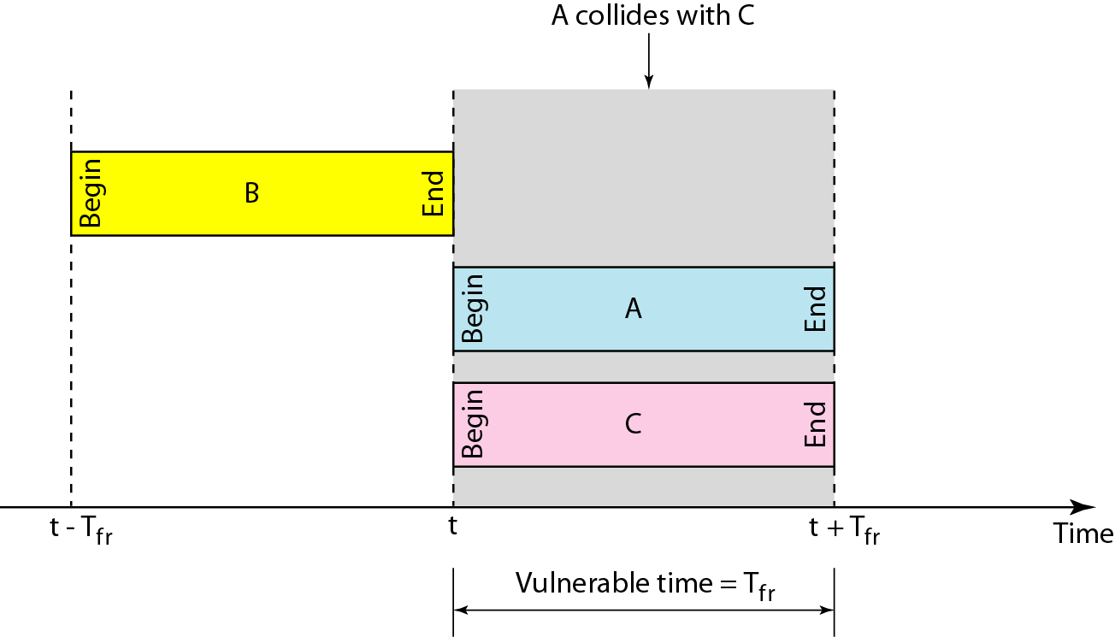
Vulnerable time for slotted ALOHA protocol

Slide 35
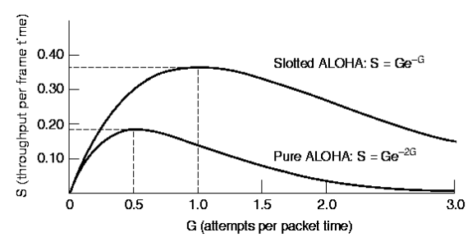
The throughput for slotted ALOHA is S = G × e^{−G} .
The maximum throughput S_{max} = 0.368 when G = 1.

Slide 36
Example
A slotted ALOHA network transmits 200-bit frames on a shared channel of 200 kbps. What is the throughput if the system (all stations together) produces
1000 frames per second b. 500 frames per second c. 250 frames per second.
Solution
The frame transmission time is 200/200 kbps or 1 ms.
a. If the system creates 1000 frames per second, this is 1 frame per millisecond. The load is 1. In this case S = G× e^{−G} or S = 0.368 (36.8 percent). This means that the throughput is 1000 × 0.0368 = 368 frames. Only 386 frames out of 1000 will probably survive.

Slide 37
Example
b. If the system creates 500 frames per second, this is (1/2) frame per millisecond. The load is (1/2). In this case S = G × e^{−G} or S = 0.303 (30.3 percent). This means that the throughput is 500 × 0.0303 = 151. Only 151 frames out of 500 will probably survive.
c. If the system creates 250 frames per second, this is (1/4) frame per millisecond. The load is (1/4). In this case S = G × e ^{−G} or S = 0.195 (19.5 percent). This means that the throughput is 250 × 0.195 = 49. Only 49 frames out of 250 will probably survive.

Slide 38
Comparison
BASIS FOR COMPARISON | PURE ALOHA | SLOTTED ALOHA
Introduced | Introduced by Norman Abramson and his associates at the University of Hawaii in 1970. | Introduced by Roberts in 1972.
Frame Transmission | The user can transmit the data frame whenever the station has the data to be transmitted. | The user has to wait till the next time slot start, to transmit the data frame.
Time | In Pure ALOHA the time is continuous. | In Slotted ALOHA the time is discrete.
Successful Transmission | The probability of successful transmission of the data frame is: S= G* e^-2G | The probability of successful transmission of the data frame is: S= G*e^-G

Slide 39
Synchronization | The time is not globally synchronized. | The time here is globally synchronized.
Throughput | The maximum throughput occurs at G = 1/2 which is 18%. | The maximum throughput occurs at G = 1 which is 37%.
Application | Aloha was the basis for Ethernet, a local area network protocol | Slotted ALOHA is used in low-data-rate tactical satellite communications networks by military forces, in subscriber-based satellite communications networks, mobile telephony call setup, set-top box communications and in the contactless RFID technologies.

Slide 40
Example
Suppose that a radio system uses a 9600 bps channels for sending call setup request messages to a base station. Suppose that packets are 120 bits long. What is the maximum throughput possible with ALOHA and with slotted ALOHA?

Slide 41
The system transmits packets at a rate =
(9600 bits/second) x (1 packet/120bits) = 80 packets/second.
The maximum throughput for ALOHA =
80 x (0.184) ≈ 15 packets/second
The maximum throughput for slotted ALOHA =
80 x (0.368) ≈ 30 packets/second

Slide 42
Carrier Sense Multiple Access (CSMA)
To minimize the chance of collision and therefore, increase the performance, the CSMA method.
The chance of collision can be reduced if a station senses the medium before trying to use it.
CSMA requires that each station first listen to the medium (or check the state of the medium) before sending.
Based on the principle “Sense before transmit” or “Listen before talk”

Slide 43
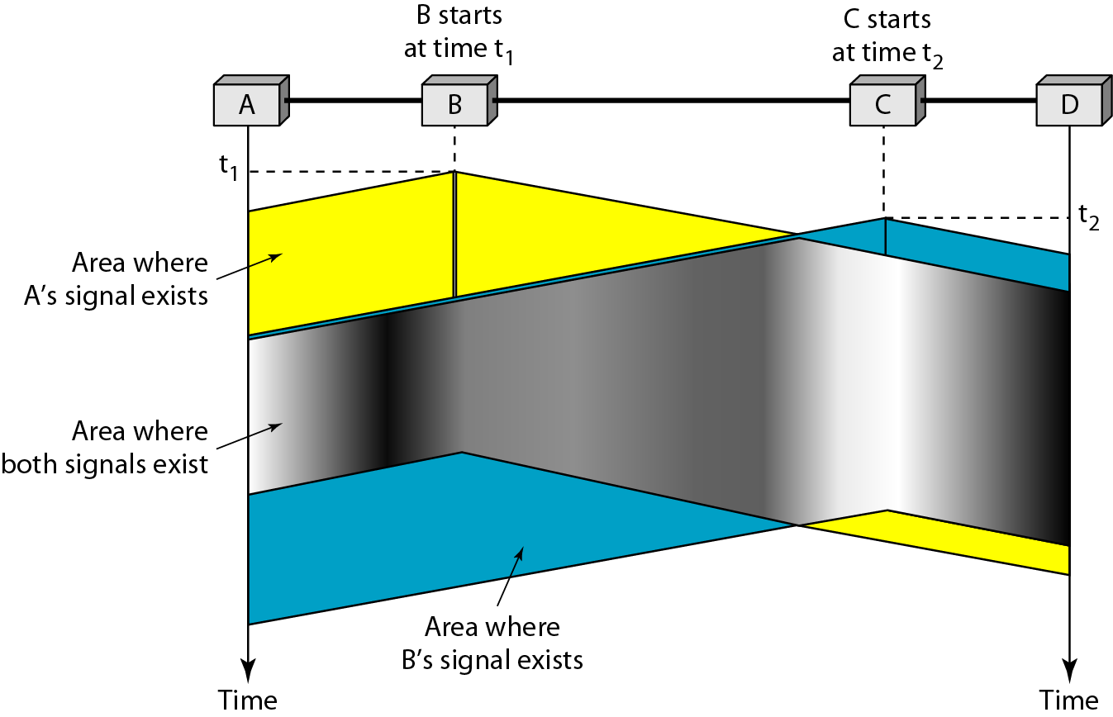
Space/time model of the collision in CSMA
t2 > t1

Slide 44
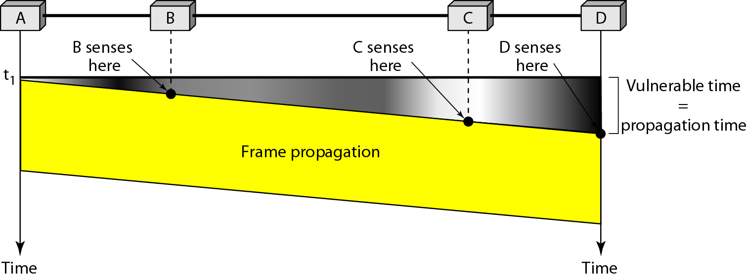
Vulnerable time in CSMA

Slide 45
Persistence methods
What should a station do if the channel is busy?
What should a station do if the channel is idle?
Three methods have been devised to answer these questions: the 1-persistent, the nonpersistent and the p-persistent method

Slide 46
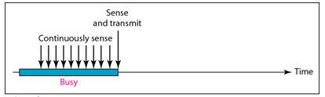
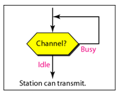
1-Persistent
The 1-persistent method is simple and straightforward. In this method, after the station finds the line idle, it sends its frame immediately (with probability 1). This method has the highest chance of collision because two or more stations may find the line idle and send their frames immediately. Ethernet uses this method

Slide 47
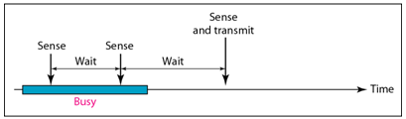
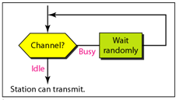
Nonpersistent
In the nonpersistent method, a station that has a frame to send senses the line. If the line is idle, it sends immediately. If the line is not idle, it waits for a random amount of time and then senses the line again. The non persistent approach reduces the chance of collision because it is unlikely that two or more stations will wait the same amount of time and retry to send simultaneously.
However, this method reduces the efficiency of the network because the medium remains idle when there may be stations with frames to send.

Slide 48
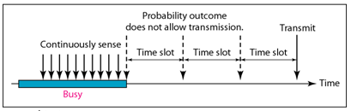
p-Persistent
The p-persistent method is used if the channel has time slots with a slot duration equal to or greater than the maximum propagation time. The p-persistent approach combines the advantage of the other two strategies. It reduces the chance of collision and improves efficiency. In this method, after the station finds the line idle it follows these steps:
1. with probability p, the station sends its frame.
2. with probability q=1-p, the station waits for the beginning of the next time slot and checks the line again.
a. if the line is idle, it goes to step 1.
b. if the line is busy, it acts as though a collision has occurred and uses the back-off procedure.

Slide 49
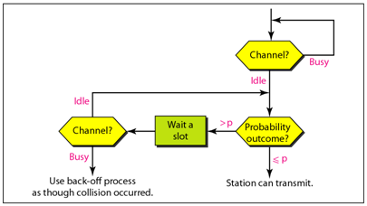
p-Persistent

Slide 50
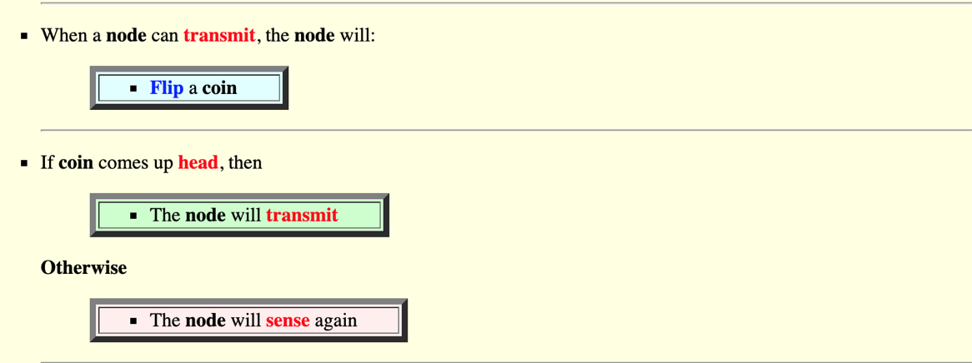
p-persistent

Slide 51
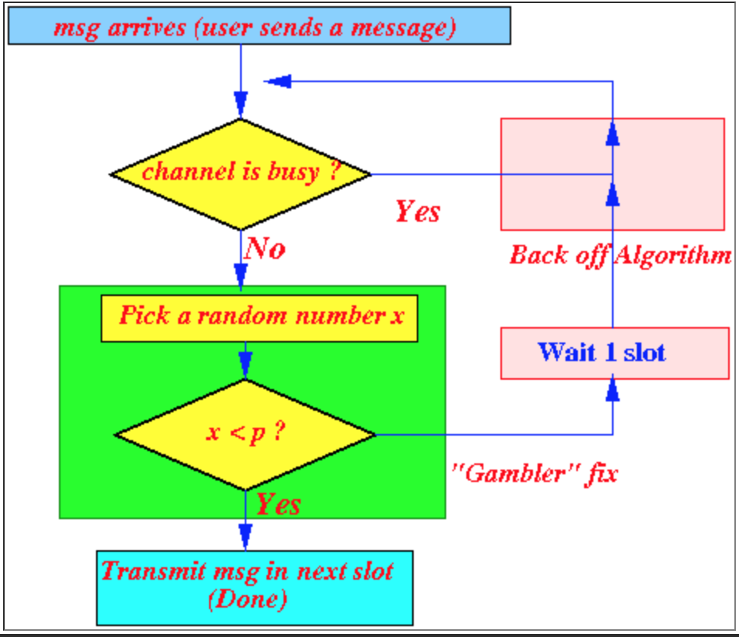

Slide 52
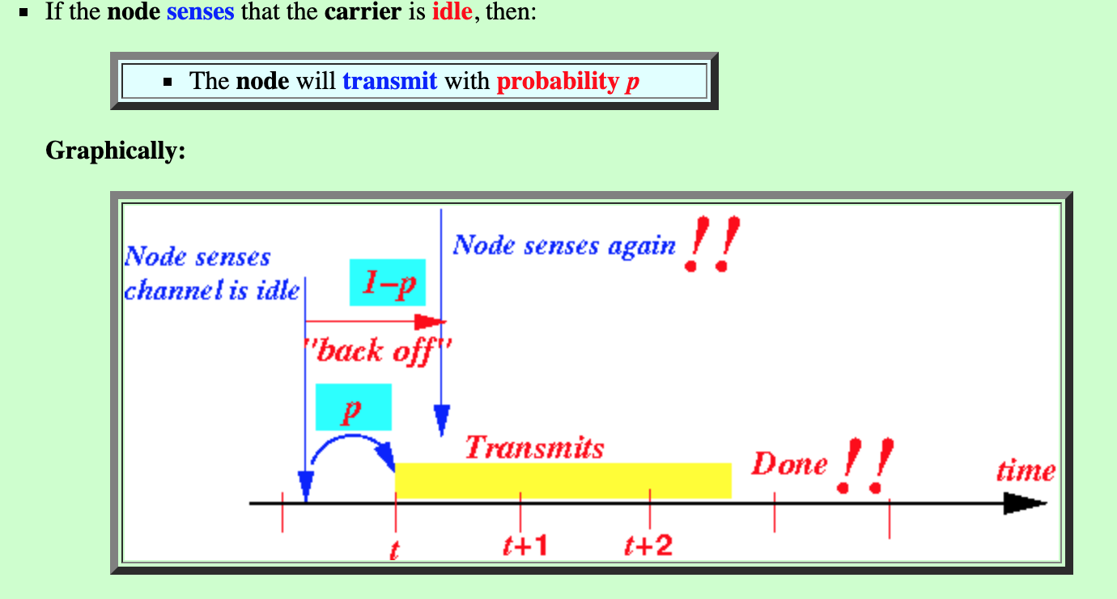

Slide 53
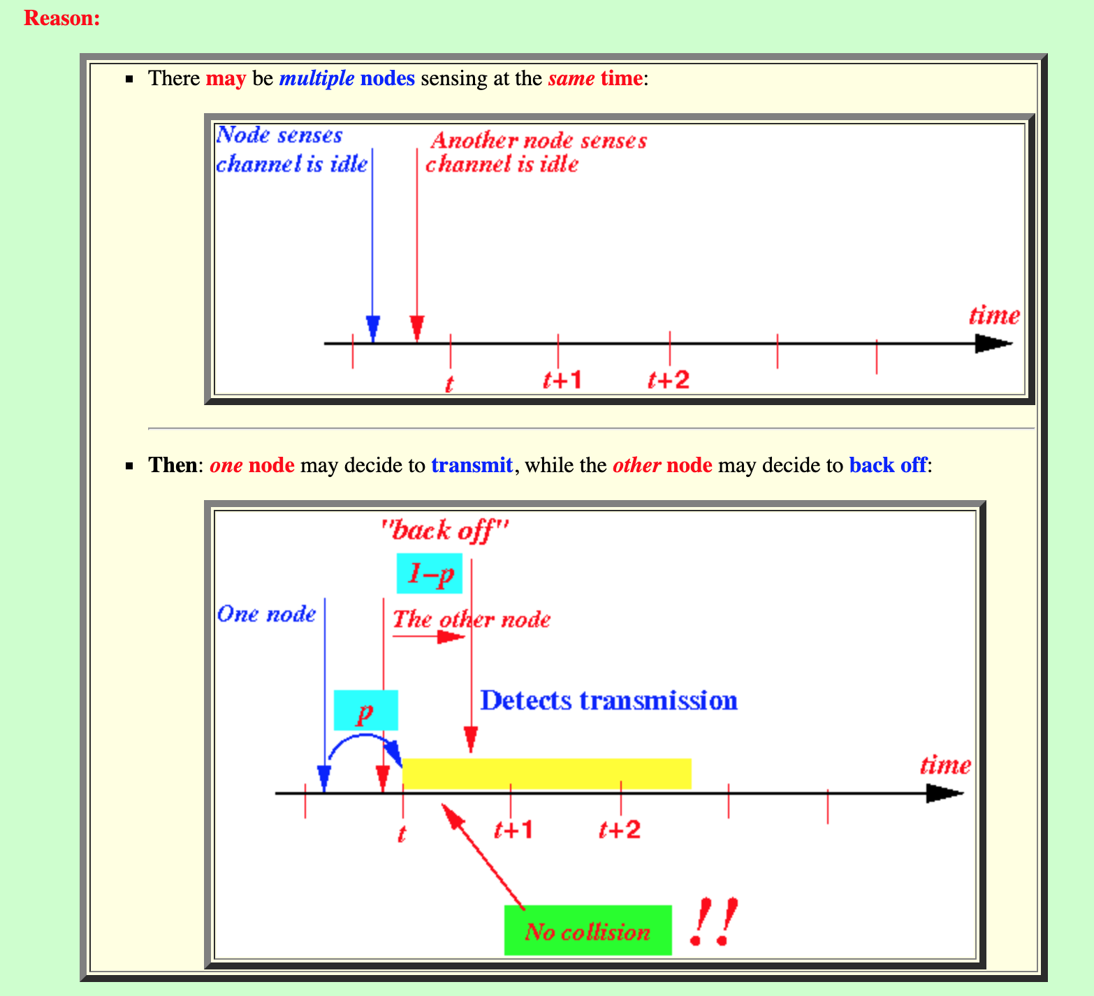

Slide 54
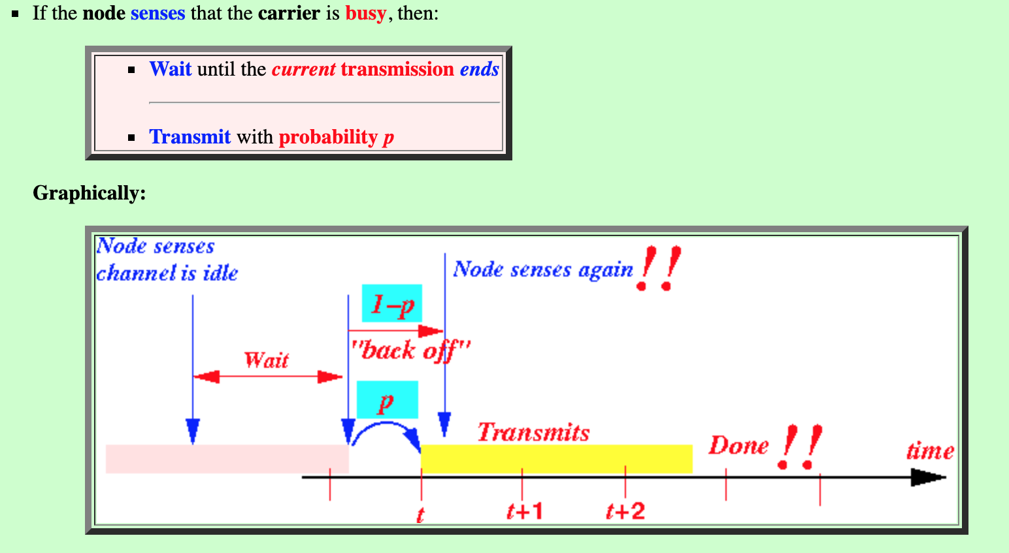

Slide 55
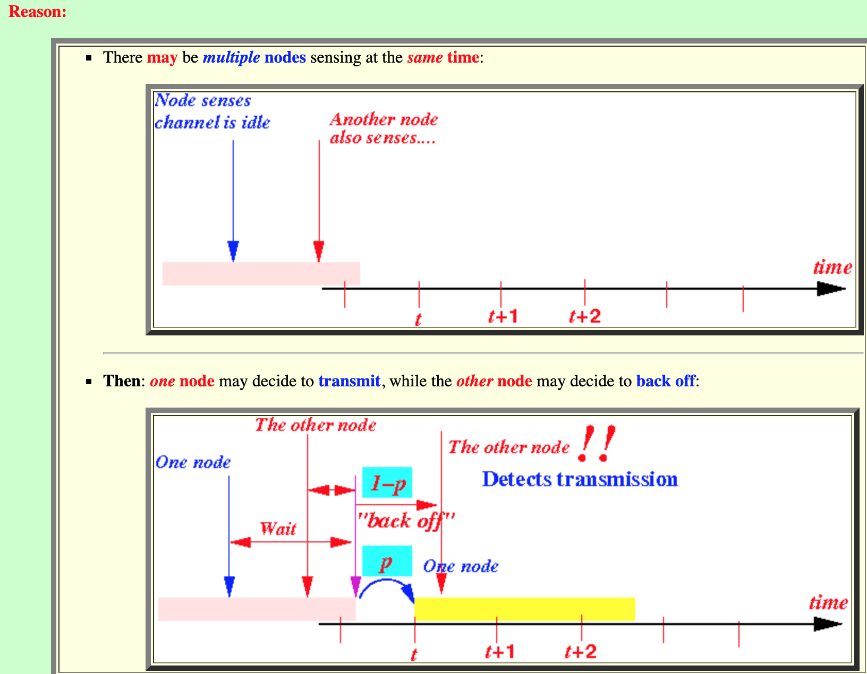

Slide 56
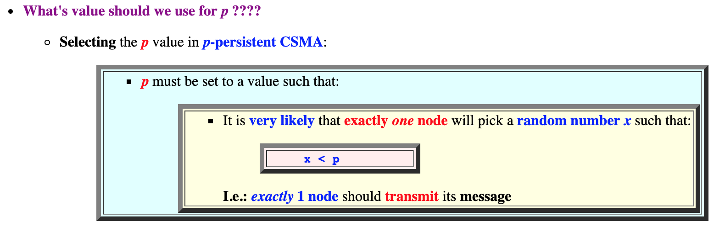

Slide 57
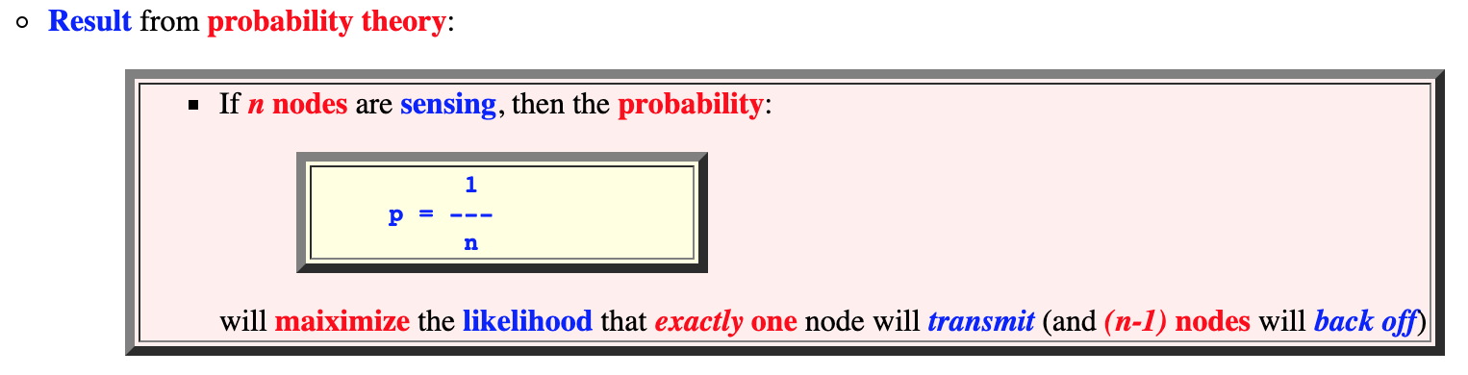

Slide 58
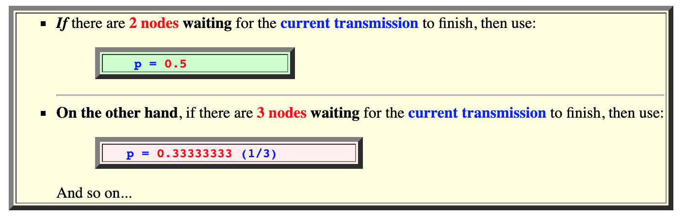

Slide 59
Problem in CSMA
The CSMA method does not specify the procedure following a collision.

Slide 60
CSMA with Collision Detection (CSMA/CD)
To overcome the problem of CSMA, CSMA with collision detection i.e., CSMA/CD augments the algorithm to handle the collision.
In CSMA/CD, a station monitors the medium after it sends a frame to see if the transmission was successful. If so, the station is done. If however, there is a collision the frame is sent again.

Slide 61
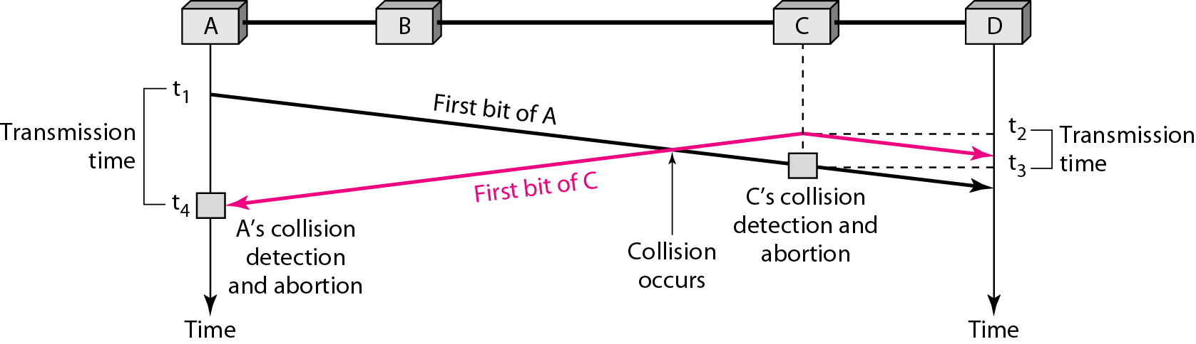
Collision of the first bit in CSMA/CD

Slide 62
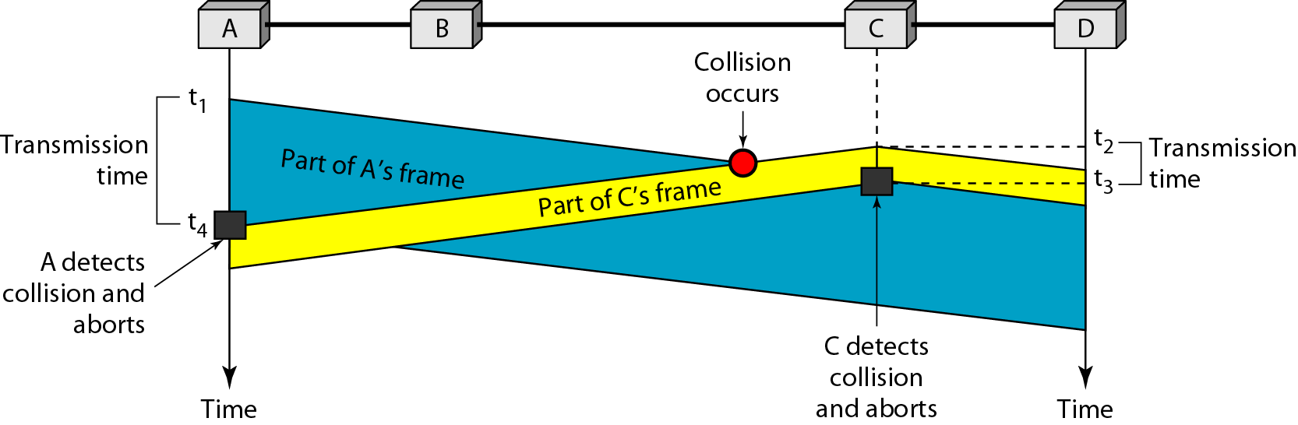
Collision and abortion in CSMA/CD

Slide 63
Minimum Frame Size
For CSMA/CD to work, we need a restriction on the frame size. Before sending the last bit of the frame, the sending station must detect a collision, if any, and abort the transmission.
This is so because the station, once the entire frame is sent, does not keep a copy of the frame and does not monitor the line for collision detection.
Therefore, the frame transmission time Tfr must be at least two times the maximum propagation time Tp.
If the two stations involved in a collision are the maximum distance apart, the signal from the first takes time Tp to reach the second, and the effect of the collision takes another time Tp to reach the first. So the requirement is that the first station must still be transmitting after 2Tp

Slide 64
Example
A network using CSMA/CD has a bandwidth of 10 Mbps. If the maximum propagation time (including the delays in the devices and ignoring the time needed to send a jamming signal, as we see later) is 25.6 μs, what is the minimum size of the frame?
Solution
The frame transmission time is T_{fr} = 2 × T_{p} = 51.2 μs. This means, in the worst case, a station needs to transmit for a period of 51.2 μs to detect the collision. The minimum size of the frame is 10 Mbps × 51.2 μs = 512 bits or 64 bytes. This is actually the minimum size of the frame for Standard Ethernet.

Slide 65
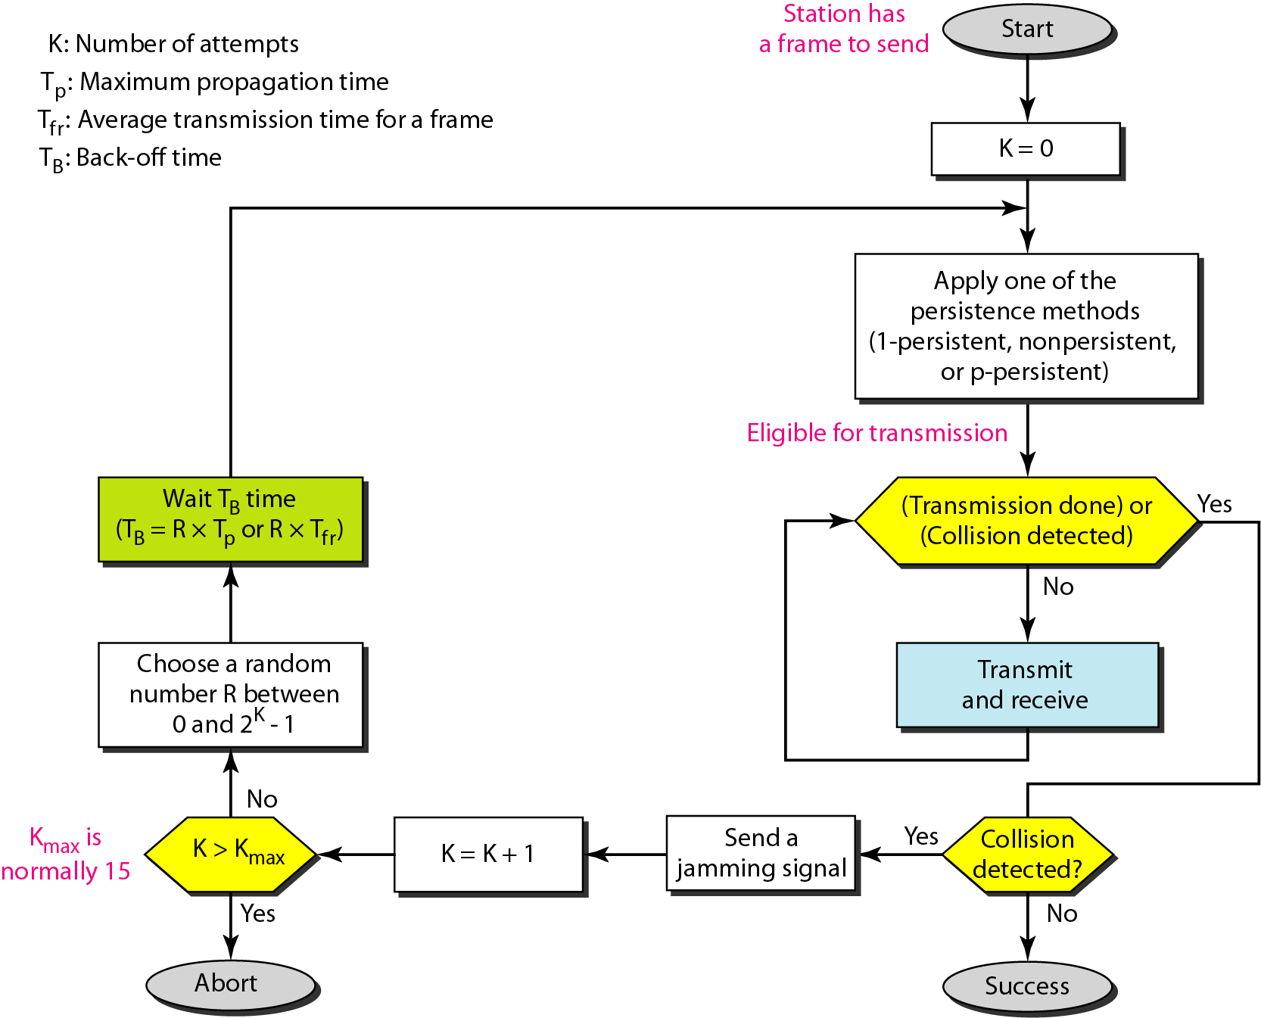
Flow diagram for the CSMA/CD

Slide 66
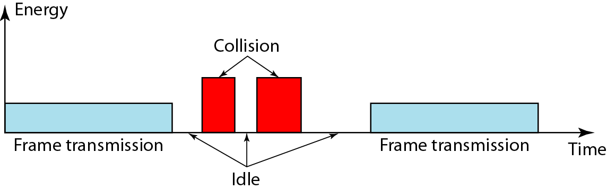
Energy level during transmission, idleness, or collision
The level of energy in a channel can have three values: zero (idle), normal (busy i.e., transmission) and abnormal (collision)

Slide 67
Basic idea behind Collision Detection
The basic idea behind CSMA/CD is that a station needs to be able to receive while transmitting to detect a collision.
When there is no collision , the station receives one signal i.e., its own signal.
When there is a collision, the station receives two signal; its own signal and the signal transmitted by the second station.
To distinguish between these two cases, the received signals in these two cases must be significantly different.
In other words, the signal from the second station needs to add a significant amount of energy to the one created by the first station.

Slide 68
If it’s a wired network …
In a wired network, the received signal has almost the same energy as the sent signal because either the length of the cable is short or there are repeaters that amplify the energy between the sender and the receiver.
This means, that in a collision, the detected energy almost doubles.

Slide 69
What if it’s a wireless network…
In a wireless network, much of the sent energy is lost in transmission (due to propagation, pathloss).
The received signal has very little energy.
Therefore, a collision may add only 5 to 10 percent additional energy.
This is not useful for effective collision detection

Slide 70
Why does CSMA/CD fail in wireless networks?
Signal strength decreases proportional to the square of the distance …obstacles attenuate the signal even further
The sender may now apply carrier sense and detect an idle medium
The sender starts sending but a collision happens at the receiver due to a second sender
It might be the case that a sender cannot “hear” the collision, i.e., CD does not work
The sender detects no collision and assumes that the data has been transmitted without errors, but a collision might actually have destroyed the data at the receiver.

Slide 71
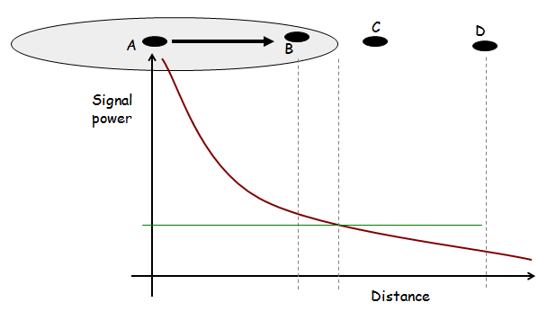
Wireless Medium Access Control

Slide 72
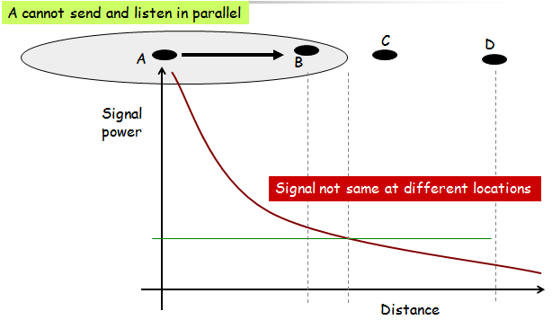
Wireless Media Disperse Energy

Slide 73

Collision Detection Difficult
Signal reception based on SINR
Transmitter can only hear itself
Cannot determine signal quality at receiver

Slide 74
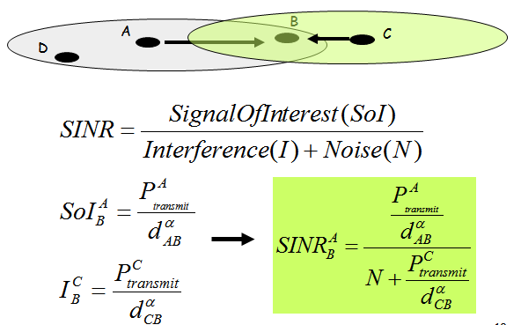
Calculating SINR

Slide 75
Issues
The main issues need to be addressed while designing a MAC protocol for ad hoc wireless networks:
Hidden and exposed terminal problems:
Hidden nodes:
Hidden stations: Carrier sensing may fail to detect another station.
Fading: The strength of radio signals diminished rapidly with the distance from the transmitter.
Exposed nodes:
Exposed stations: B is sending to A. C can detect it. C might want to send to E but conclude it cannot transmit because C hears B.
Collision masking: The local signal might drown out the remote transmission.
Error-Prone Shared Broadcast Channel
Distributed Nature/Lack of Central Coordination
Mobility of Nodes: Nodes are mobile most of the time.

Slide 76
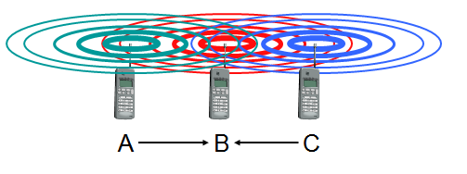
Motivation – Hidden Terminal Problem
A sends to B, C cannot receive A
C wants to send to B, C senses a “free” medium (CS fails)
collision at B, A cannot detect the collision (CD fails)
A is “hidden” for C

Slide 77
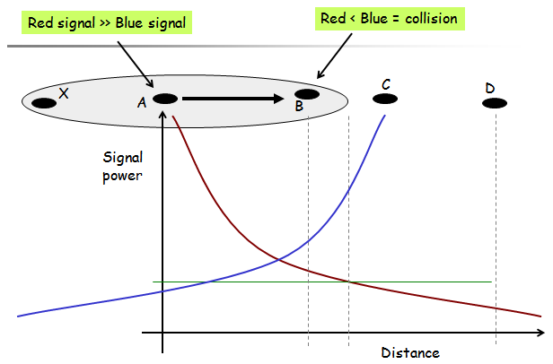

Slide 78
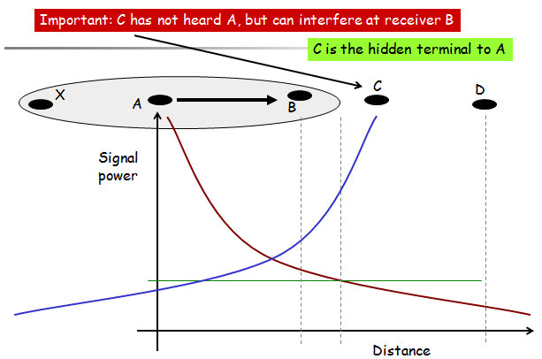

Slide 79
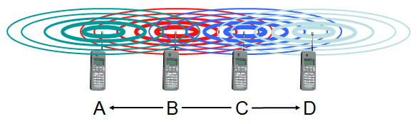
Motivation – Exposed Terminal Problem
B sends to A, C wants to send to D
C has to wait, CS signals a medium in use
since A is outside the radio range of C (waiting is not necessary)
C is “exposed” to B

Slide 80
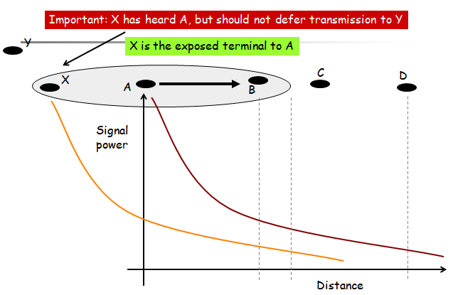

Slide 81
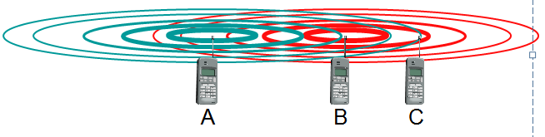
Motivation - Near and Far Terminals
Terminals A and B send, C receives
the signal of terminal B hides A’s signal
C cannot receive A
This is also a severe problem for CDMA networks
precise power control required

Slide 82
Solutions
Busy Tone
A receiver transmits busy tone when receiving data
All nodes hearing busy tone keep silent
Avoids interference from hidden terminals
Requires a separate channel for busy tone

Slide 83
CSMA with Collision Avoidance (CSMA/CA)
We need to avoid collisions on wireless networks because they cannot be detected.
CSMA/CA was invented for this network.
Collisions are avoided through the use of CSMA/CA’s three strategies:
The interframe space
The contention window
Acknowledgements

Slide 84
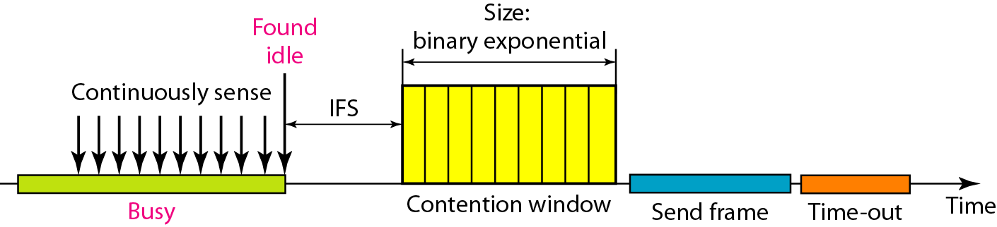
Timing in CSMA/CA

Slide 85
Interframe space
Collisions are avoided by deferring transmission even if the channel is found idle.
When an idle channel is found, the station does not send immediately. It waits for a period of time called the interframe space or IFS.
Even though the channel may appear idle when it is sensed, a distant station may have already started transmitting.
The distant station’s signal has not yet reached this station.
The IFS time allows the front of the transmitted signal by the distant station to reach this station.
If after the IFS time the channel is still idle, the station can send, but it still needs to wait a time equal to the contention time.
The IFS variable can also be used to prioritize stations or frame types. For example, a station that is assigned a shorter IFS has a higher priority.

Slide 86
Contention window
The contention window is an amount of time divided into slots.
A station that is ready to send choose a random number of slots as its wait time.
The number of slots in the window changes according to the binary exponential back-off strategy.
This means that it is set to one slot the first time and then doubles each time the station cannot detect an idle channel after the IFS time. This is very similar to the p-persistent method except that a random outcome defines the number of slots taken by the waiting station.
In CSMA/CA, if the station finds the channel busy, it does not restart the timer of the contention window; it stops the timer and restarts it when the channel becomes idle.
This gives priority to the station with the longest waiting time.

Slide 87
Acknowledgement
With all these precautions, there still may be a collision resulting in destroyed data.
In addition, the data may be corrupted during the transmission.
The positive acknowledgement and the time-out timer can help guarantee that the receiver has received the frame.

Slide 88
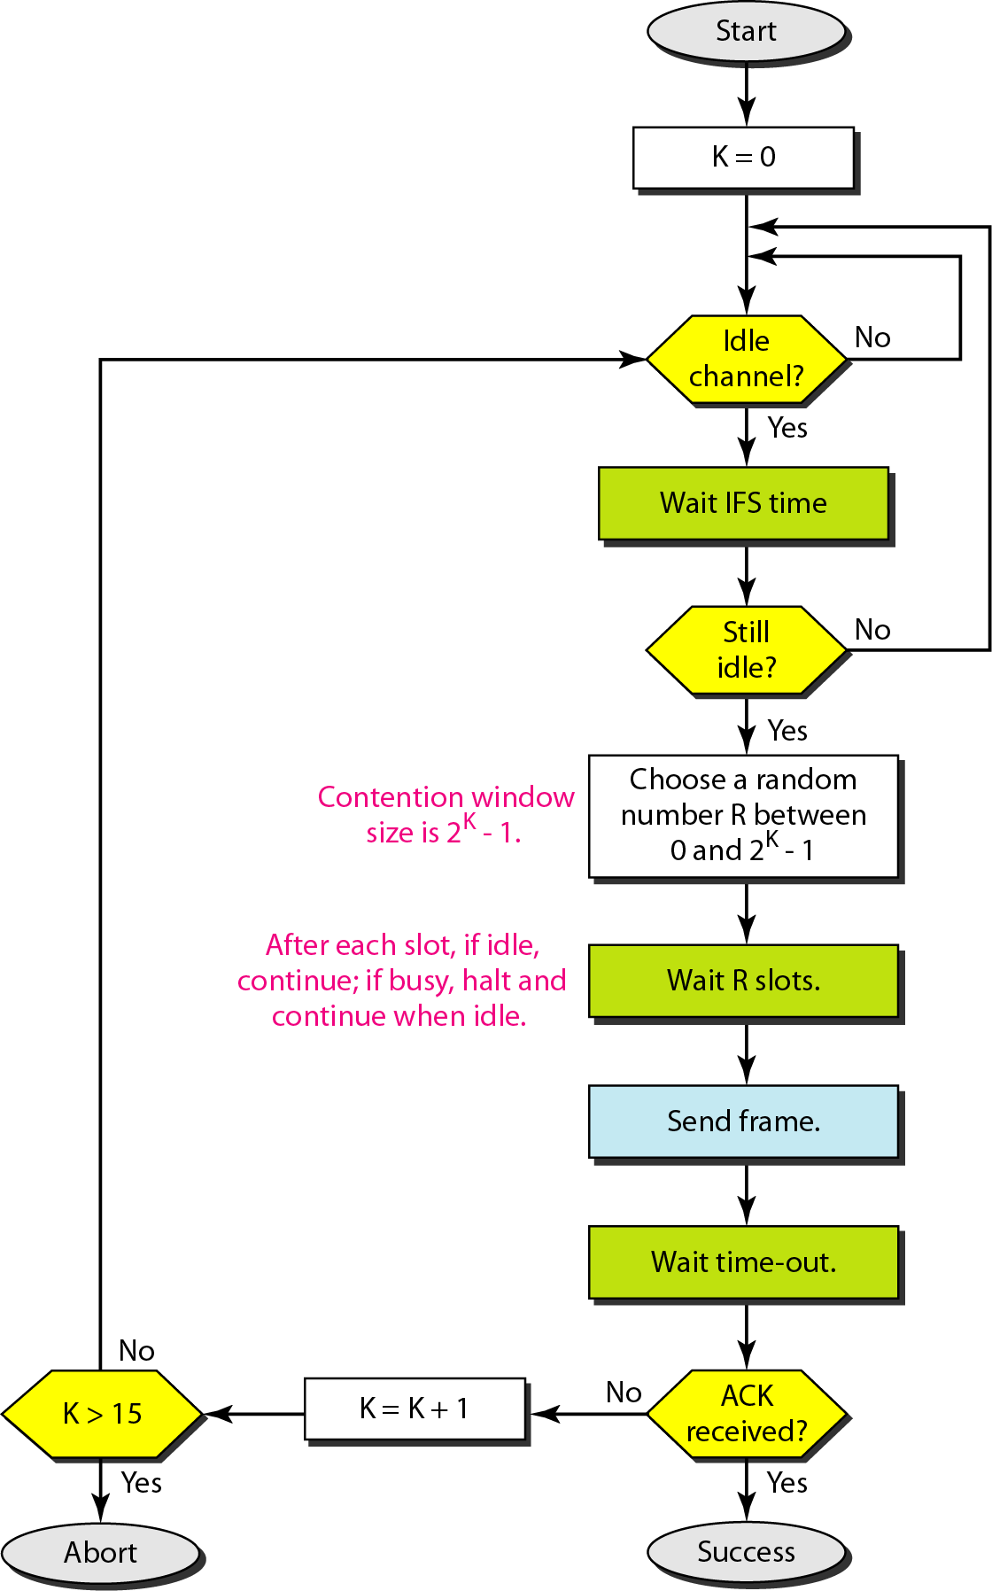
Flow diagram of CSMA/CA

Slide 89
MACA
MACA (Multiple Access Collision Avoidance )
When node A wants to send a packet to node B, node A first sends a Request-to-Send (RTS) to B
On receiving RTS, node B responds by sending Clear-to-Send (CTS), provided node B is able to receive the packet
If a packet transmitted by a node is lost, the node uses the binary exponential back-off (BEB) algorithm to back off a random interval of time before retrying
When a node (such as C) overhears a CTS, it keeps quiet for the duration of the transfer
Transfer duration is included in RTS and CTS both

Slide 90
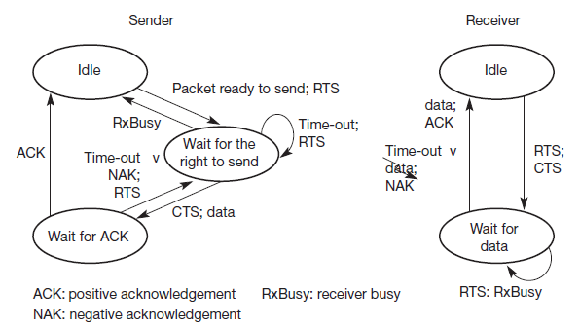
Simplified state machines for a sender and receiver

Slide 91
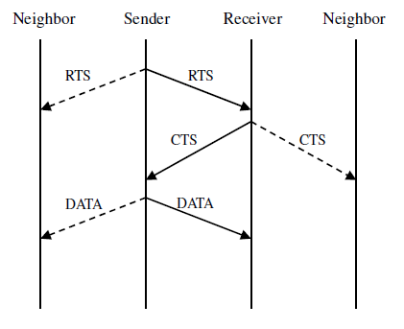
Packet transmission in MACA

Slide 92
Receiver informs interferers before transmission – MACA
Sender B asks receiver C whether C is able to receive a transmission Request to Send (RTS)
Receiver C agrees, sends out a Clear to Send (CTS)
Potential interferers overhear either RTS or CTS and know about impending transmission and for how long it will last
Store this information in a Network Allocation Vector
B sends, C acks
! MACA protocol (used e.g. in IEEE 802.11)

Slide 93
RTS/CTS
RTS/CTS ameliorate, but do not solve hidden/exposed terminal problems

Slide 94
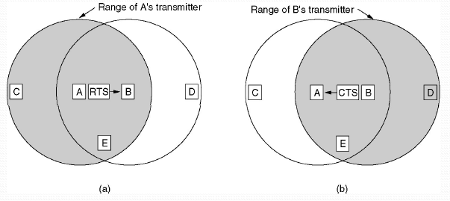
The MACA protocol
(a) A sending an RTS to B (b) B responding with a CTS to A

Slide 95
Backoff Interval
Backoff intervals used to reduce collision probability
When transmitting a packet, choose a backoff interval in the range [0,cw]
cw is contention window
Count down the backoff interval when medium is idle
Count-down is suspended if medium becomes busy
When backoff interval reaches 0, transmit RTS

Slide 96
Backoff Interval
The time spent counting down backoff intervals is a part of MAC overhead
Choosing a large cw leads to large backoff intervals and can result in larger overhead
Choosing a small cw leads to a larger number of collisions (when two nodes count down to 0 simultaneously)

Slide 97
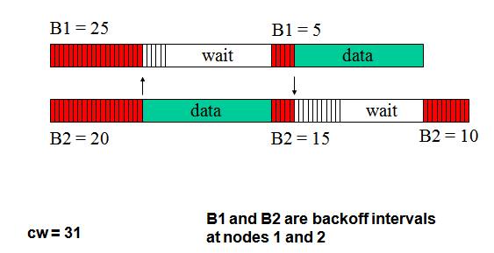
Example

Slide 98
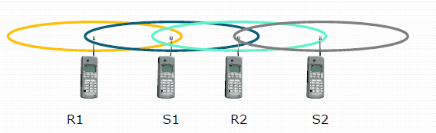

Problem with MACA
The binary exponential back-off mechanism used in MACA might starve flows sometimes
The problem is solved by MACAW

Slide 99
Solution
Back-off algorithm has been modified by Bharghavan in 1994
Packet header has an additional filed carrying the current back-off counter value of the transmitting node
A node receiving the packet copies this value into its own back-off counter
To prevent large variations in the back-off values
A multiplicative increase and linear decrease (MILD) is used in MACAW
Collision: back-off is increased by a multiplicative factor (1.5)
Successful: back-off is decreased by one
Implement per flow fairness as opposed to the per node fairness
Multiple queues at every node (running backoff algorithm independently)

Slide 100
Controlled Access
In controlled access, the stations consult one another to find which station has the right to send. A station cannot send unless it has been authorized by other stations. We discuss three popular controlled-access methods.
Reservation
Polling
Token Passing

Slide 101

Reservation
In reservation method, a station needs to make a reservation before sending data. Time is divided into intervals. In each interval, a reservation frame precedes the data frames sent in that interval.
If there are N stations in the system, there are exactly N reservation minislots in the reservation frame. Each minislot belongs to a station. When a station needs to send a data frame, it makes a reservation in its own minislot. The station that have made reservations can send their data frames after the reservation frame.

Slide 102

Polling
Polling work with topologies in which one device is designated as a primary station and the other devices are secondary stations.
All data exchanges must be made through the primary device; the primary device controls the link, therefore, it is always the initiator of a session.
Poll: If the primary wants to receive data, it asks the secondary nodes if they have anything to send.
Select: If the primary wants to send data, it tells the secondary nodes to get ready to receive.

Slide 103

Token passing
In the token passing method, the station in a network are organized in a logical ring.
A special packet called a token circulates through the ring. The possession of the token gives the station the right to access the channel and send its data.
Token management is needed for this access method.

Slide 104
Channelization
Channelization is a multiple-access method in which the available bandwidth of a link is shared in time, frequency, or through code, between different stations. In this section, we discuss three channelization protocols.
Frequency-Division Multiple Access (FDMA)
Time-Division Multiple Access (TDMA)
Code-Division Multiple Access (CDMA)

Slide 105

FDMA
In FDMA, the available bandwidth is divided into frequency bands.
Each station is allocated a band to send its data.
Each station uses a bandpass filter to confine the transmitter frequencies.
To prevent station interferences, the allocated bands are separated from one another by small guard bands.

Slide 106

TDMA
In TDMA, the bandwidth is just one channel that is timeshared between different stations.
The main problem with TDMA lies in achieving synchronization between the different stations.
Each node needs to know the beginning of its slot and the location of its slot.
This may be difficult because of propagation delays if the stations are spread over a large area.

Slide 107

CDMA
CDMA was conceived several decades ago..with advancement on electronic technology recently implemented .
In CDMA, one channel carries all transmissions simultaneously.

Slide 108
Chip sequences

Slide 109
Data representation in CDMA

Slide 110

Sharing channel in CDMA

Slide 111

Digital signal created by four stations in CDMA

Slide 112

Decoding of the composite signal for one in CDMA

Slide 113

General rule and examples of creating Walsh tables

Slide 114
The number of sequences in a Walsh table needs to be N = 2^{m}.

Slide 115
Example
Find the chips for a network with
a. Two stations b. Four stations
Solution
We can use the rows of W2 and W4 in Figure 12.29:
a. For a two-station network, we have [+1 +1] and [+1 −1].
b. For a four-station network we have [+1 +1 +1 +1], [+1 −1 +1 −1], [+1 +1 −1 −1], and [+1 −1 −1 +1].

Slide 116
Example
What is the number of sequences if we have 90 stations in our network?
Solution
The number of sequences needs to be 2^{m}. We need to choose m = 7 and N = 2⁷ or 128. We can then use 90 of the sequences as the chips.

Slide 117
Example
When we divide the result by N, we get d1 .

